Slide 1
Warm welcome
To all..

Slide 2
College website Template
Yogeshwar Manerikar

Slide 3
Contents
Purpose
College logo & Moto
Focus
Site Map
Menu
Users
Invective's
Why to choose our website ?
Demo
Reference

Slide 4
PURPOSE
Every student wants knowledge with short span of time .
College is going online so many people visits the site and make some opinion for future use .So college get more students .
we choose to do it better and change the concept of college website with giving the innovative ideas .

Slide 5

College logo & Moto
We offer the smart things to plan study,
Do the study and deliberate success.
Wings to fly & cross the boundary's
Light to spread
Build the future

Slide 6

01
Focus on college Students
02
Connect Student- Parent - Teacher
03
Student do smart things , with smart way

Slide 7
Site Map
Top Menu
Home
Faculty
Registration
Course
Contact Us
Admission
Online courses
Calendar
Faculty profile
For Students
B.A.
Online Form
Udacity
B.Com
News
Swayam
Events
Study tonight
Results
BSc.
W3C
About Us
Location Map
Follow us
Visitors count

Slide 8
menu
Online Courses
Registrations
Contact Us
Faculty
Course
Admissions

Slide 9
User’s
Faculty
College Students
Parents

Slide 10
Invective's
Results
Calendar
Visitors count
User section
Online Courses

Slide 11
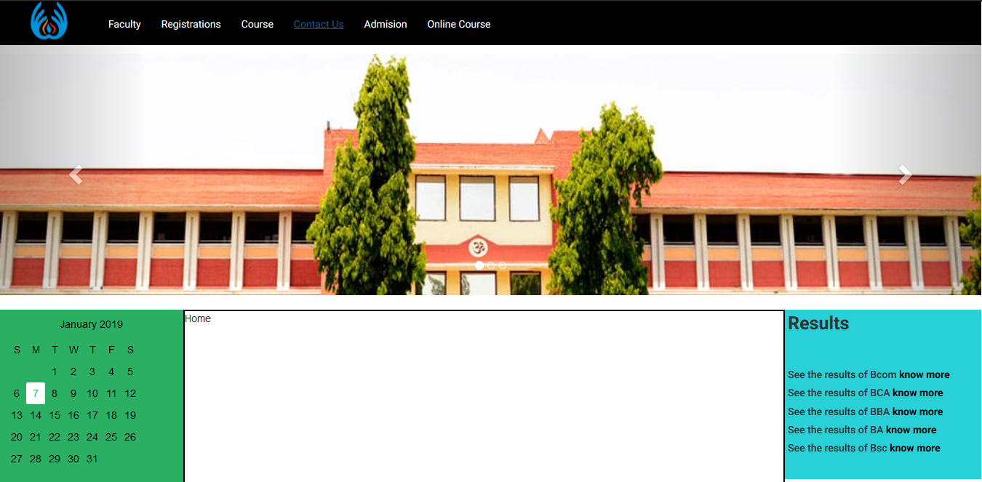
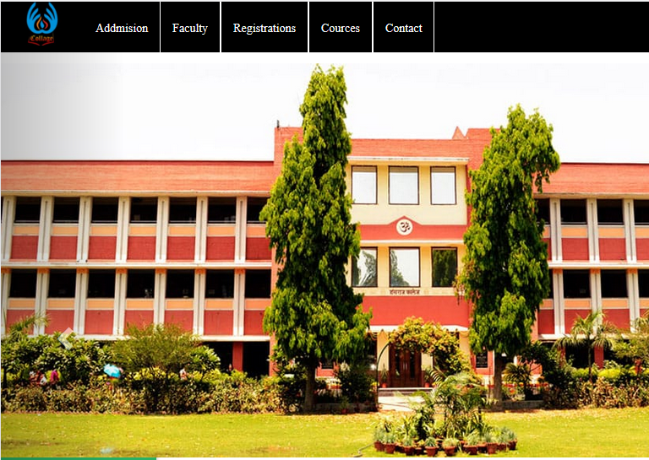
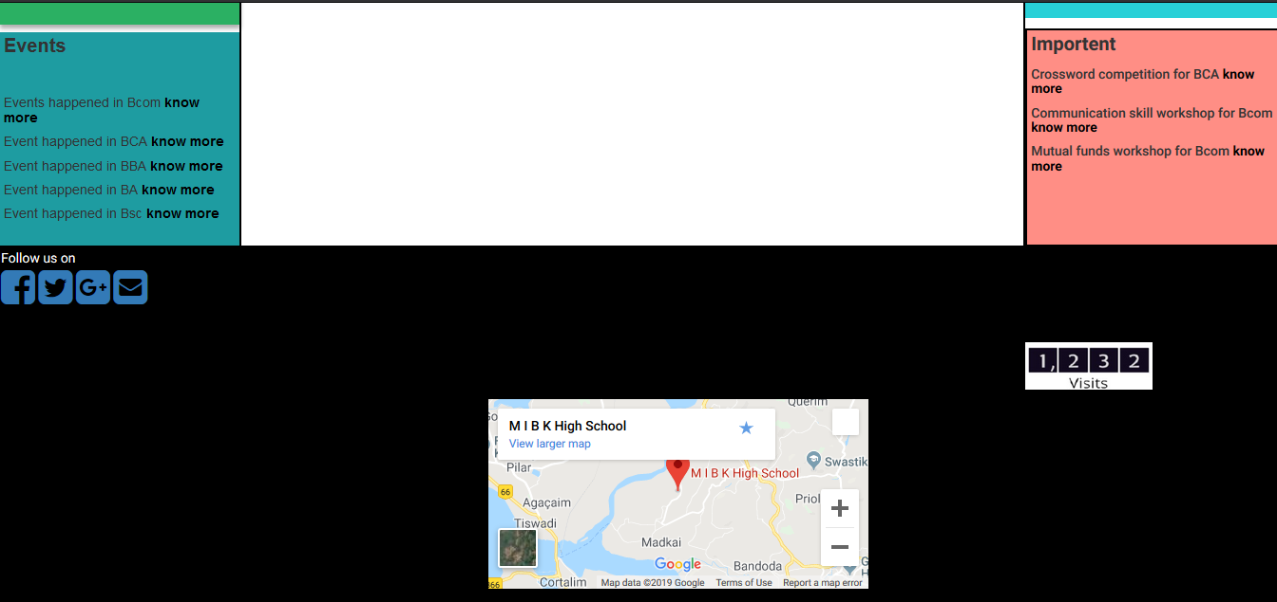
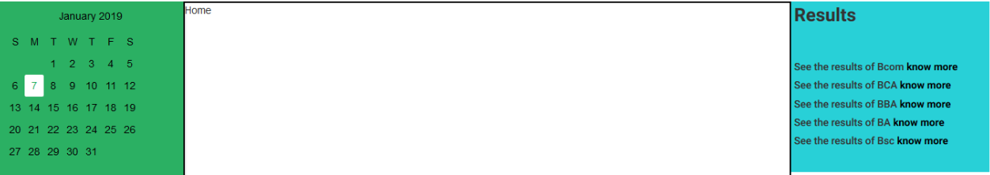
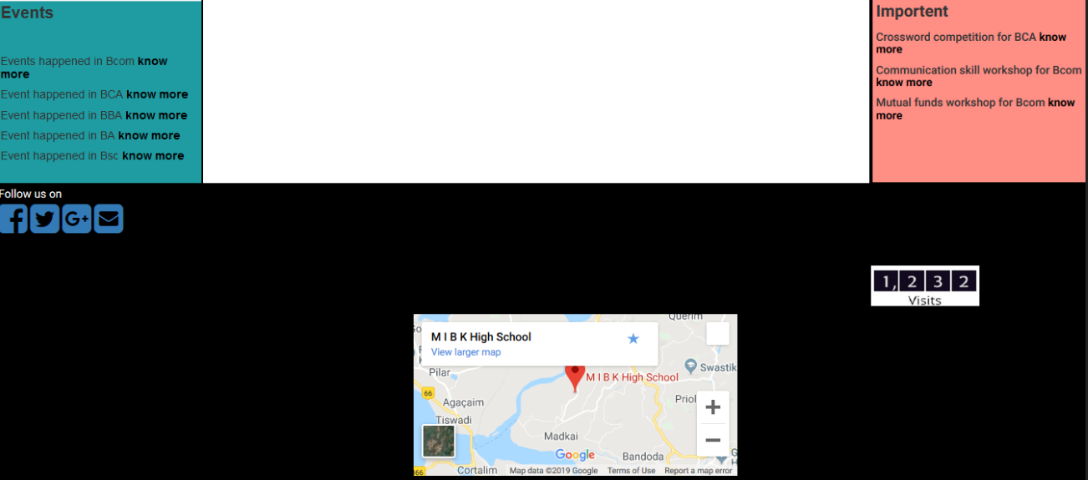

Slide 12
Why to choose our website ?
It contains smart ways to connect to links .
It gives reminder for Events ,Exam , PTA mattings, industrial visit.
Online admission.
Visitors count with category of user.
Provide some free online courses for students & faculty's.
Available 24x7

Slide 13
Reference
For Drawing Site Map
https://college1.slickplan.com
For Create basic forms
https://www.jotform.com/myforms
For some new concepts
https://www.w3schools.com/
For reference
http://www.gmfc.ac.in/
http://www.mesgarwarecollege.org/
http://www.fergusson.edu/
http://rosarycollege.org/
For Bootstrap
http://wowslider.com/
For static Maps
https://www.mapsdirections.info/en/custom-google-maps/

